Slide 1
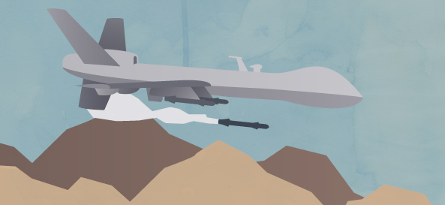
The Drone War Fall 2012 COMS 4115
George Brink
Shuo Qiu
Xiaotong Chen
Xiang Yao

Slide 2

The Drone War
A stack-based Imperative language
Applied to designed game
Simple
Interesting
Powerful

Slide 3
The Drone War
Motivation
Simple enough to be understood by users who know nothing about programming
Efficient AI programs to be applied to simultaneous games (one tick per operation)

Slide 4
The Drone War
Project Overview
The Drone War stack-based language
The GUI Drone War programming game
AI of drones in which the language is applied to the game

Slide 5
The Drone War
Introduction to Drone Language
Keywords
Function
Types
Dup, drop, dropall, swap, over, rot, read, store, jump, jumpif, sub, endsub, if, else, endif, begin, while, again, move, stop, shoot, look, wait, gethealth, random, isfoe, isally, iswall, isend, mod, and, or, not
sub add_one
1 +
endsub
1 add_one
// 1 + 1
Integer, boolean, flag (wall, foe, ally, end)

Slide 6
The Drone War
Language Tutorial
Variables
Operators
Game specific functions
2 a store
a read 2 +
// 2 + 2
+, -, *, /, mod, ^
And, Or, Not, =, <, >
Move, stop, shoot, look, isfoe, isally, iswall, isend, wait, gethealth, random

Slide 7
The Drone War
Language Tutorial
Condition branches
Branches
// if
condition if
actions end_if
//if else
condition if
actions
else
actions
end_if

Slide 8
The Drone War
Language Tutorial
Loops
Endless loop
Conditional loop
begin
actions
again
// repeat actions again and again until dead
begin
condition
while
actions
again
// repeat actions if condition is true

Slide 9
The Drone War
Game Introduction
Fighting each other in square arena size of 1000*1000
Each drone is controlled by AI written in Drone Language, and automatically moves, searches and shoots
Drone freeze once died or illegal command is detected

Slide 10
The Drone War
Arena Introduction
Control all drone and bullet objects inside the arena area
Implement tick operations and update status of all objects
Interact with GUI and visualize positions and status of objects

Slide 11
The Drone War
Drone Introduction
Each drone contains info of positions, directions, health, status and etc.
After each tick operation, variables updated by arena based on byte code compiled from AI
Store user defined variables and subs, and helper functions are also available

Slide 12
The Drone War
AI examples
100 health store // set variable health to 100
main_loop:
10 wait // wait for 0.1 of the second
// read the stored value of health
// read the current health and compare it with the old value
health read getHealth =
// repeat indefinetely if no one harmed the drone LABEL & JUMP main_loop jumpif
// what to do if drone recieved some damage
0 359 random // get a random value in the range 1-360
move // move in the random direction
10 wait // wait for 0.1 seconds
stop // stop
main_loop jump // and go back to the beginning

Slide 13
The Drone War
AI examples
0 direction store
// keep moving to different walls, seek foe to shoot
begin
dropall
0 shoottime store
0 360 random
direction store
// moving
direction read move
// move to the wall stop before hitting
begin
direction read look
begin
iswall not
while
drop drop
again
drop
20 >
while
again
// stop moving
stop
begin
// lay on the wall and look backward
direction read 180 + look
begin
dup
isfoe not
swap
iswall not
and
while
drop drop
again
// shoot foe
shoot
shoottime read 1 + shoottime store
shoottime read 10 <
while
again
// repeat it until die
again
LOOPS

Slide 14
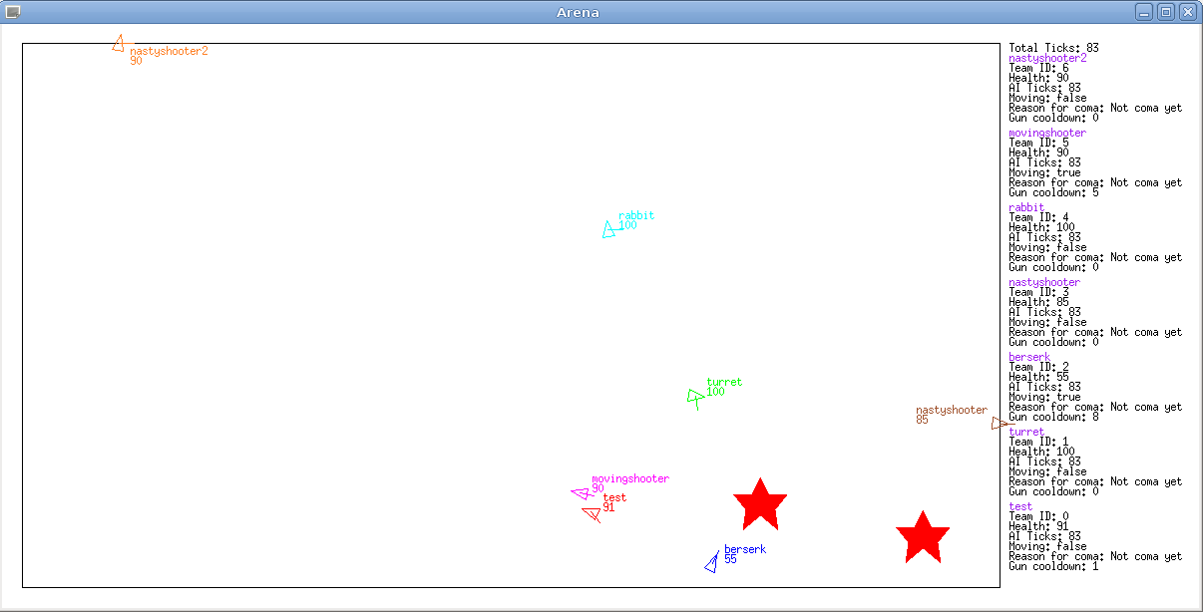
The Drone War
GUI examples

Slide 15
The Drone War
Summary
It is useful to apply class materials such as stack based operation to our language
Stack-based language is always compact, efficient and easy to understand
A good design and a good team leader always make good progress

